Slide 1
ICEBIN: Image Contrast Enhancement Based on Induced Norm and Local Patch Approaches
Advisor: Chiou-Shann Fuh
Department of Computer Science and Information Engineering
National Taiwan University
Taipei, Taiwan
fuh@csie.ntu.edu.tw
Student: Tzu-Chia Tung
Graduate Institute of Networking and Multimedia
National Taiwan University
Taipei, Taiwan
0925708818
D04944016@ntu.edu.tw

Slide 2
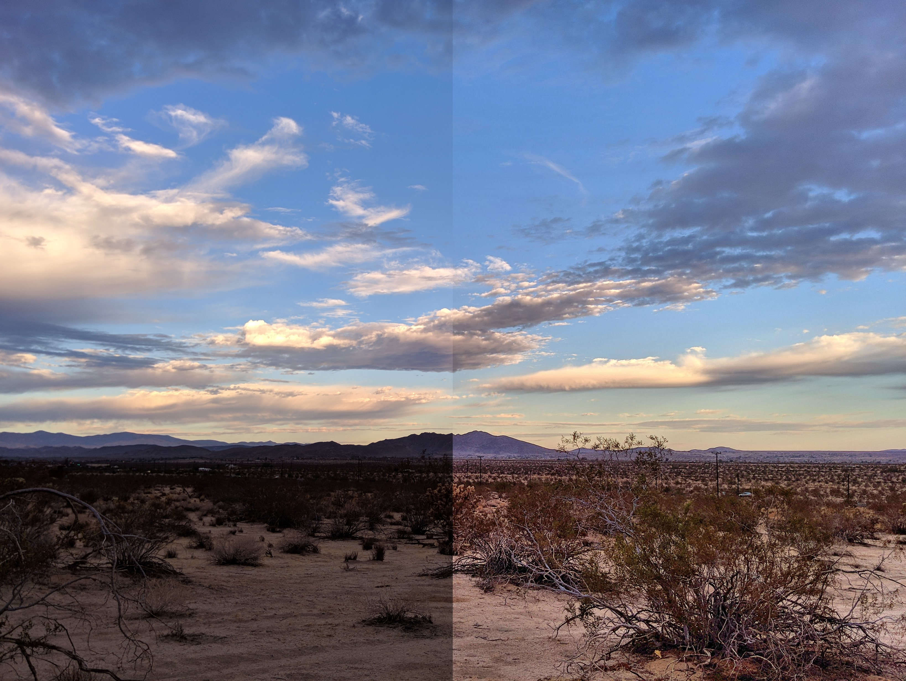
I. Introduction
Recently, the requirement for digital photography and multimedia applications has been increasing. One of these requirements is to obtain as much complete image dynamic range information as possible, which is called High Dynamic Range (HDR) imaging.
Notes:
近來，對數字攝影和多媒體應用的需求已經增加。 這些要求之一是獲取盡可能多的完整圖像動態範圍信息，稱為高動態範圍（HDR）成像。

Slide 3
II. Related Works
The image contrast enhancement is mainly divided into two mainstream ideas: based on Histogram Equalization and based on the Retinex algorithm.
Notes:
圖像對比度增強主要分為兩個主流思想：基於直方圖均衡和基於Retinex算法。

Slide 4
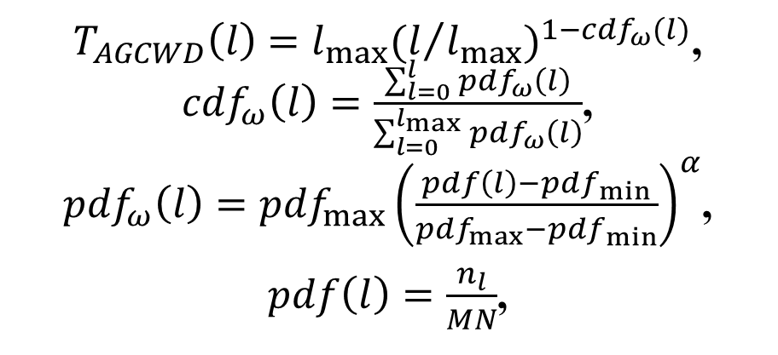
A. Gamma Correction
Huang et al. [35] employed a Compensated Cumulative Distribution Function (CDF) as an adaptive parameter, modifying the intensity with a progressive increment of the original trend. The proposed Adaptive Gamma Correction with Weighting Distribution (AGCWD) is formulated as follows:
$T_{AGCWD}\left(l\right)=l_{max}{(l/{l_{max}})}^{1−{cdf}_{ω}(l)}$,
${cdf}_{ω}\left(l\right)=\frac{\sum_{l=0}^{l}{{pdf}_{ω}\left(l\right)}}{\sum_{l=0}^{l_{max}}{{pdf}_{ω}\left(l\right)}}$,
${pdf}_{ω}\left(l\right)={pdf}_{max}{\left(\frac{pdf\left(l\right)−{pdf}_{min}}{{pdf}_{max}−{pdf}_{min}}\right)}^{α}$,
$pdf\left(l\right)=\frac{n_{l}}{MN}$,
Notes:
黃等。 [35]採用補償累積分佈函數（CDF）作為自適應參數，以原始趨勢的漸進增量來修改強度。 擬議的具有權重分佈的自適應伽馬校正公式如下：

Slide 5
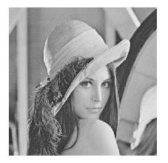
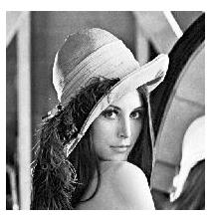
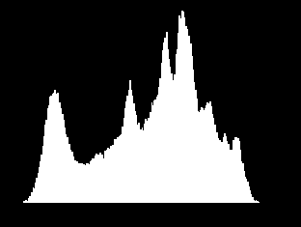
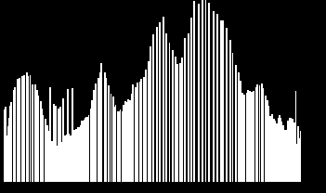
B. Histogram Equalization
Image
Enhancement
Histogram
Equalization

Slide 6
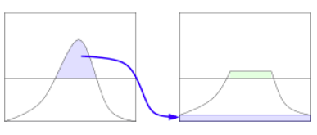
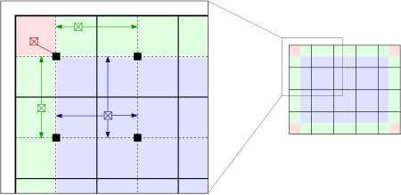
B. Histogram Equalization
In order to solve the problem of excessive magnification, the method of Contrast Limited Adaptive Histogram Equalization (CLAHE) is used [47].
Notes:
為了解決放大倍數過大的問題，使用了對比度受限的自適應直方圖均衡化方法（CLAHE）[47]。

Slide 7
C. Retinex Algorithm
The Retinex algorithm [22] was first proposed by Edwin Land (1964). It first introduced human visual characteristics into the literature in the field of image enhancement research.
Notes:
Retinex算法[22]由Edwin Land（1964）首次提出。 它首先將人的視覺特徵引入了圖像增強研究領域的文獻中。

Slide 8
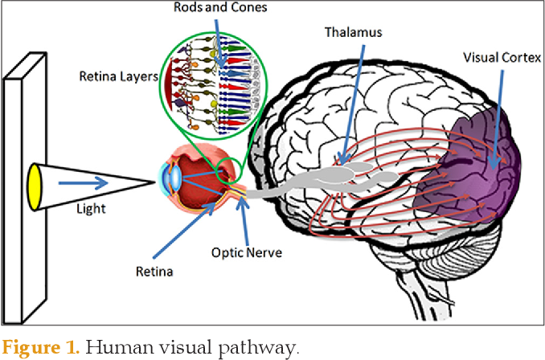
C. Retinex Algorithm
The Retina and Cortex process this color perception ability in the human brain. In human vision, the stimulus value of the image is obtained by the retina (Retina). Then the color information obtained by the retina of the cerebral cortex (Cortex) is used to know the color of the object.
Notes:
視網膜和皮質在人腦中處理這種顏色感知能力。 在人類視覺中，圖像的刺激值是由視網膜（Retina）獲得的。 然後，通過大腦皮層（Cortex）的視網膜獲得的顏色信息可以知道物體的顏色。
Thalamus(視丘)

Slide 9
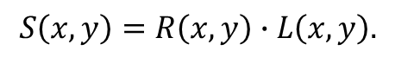
C. Retinex Algorithm
The model was extended to decompose the image S into two different images, namely the reflectivity image R and the illumination image L as follows.
$$S\left(x, y\right)=R\left(x, y\right)∙L\left(x, y\right).$$
Notes:
擴展該模型以將圖像S分解為兩個不同的圖像，即反射率圖像R和照明圖像L，如下所示。

Slide 10
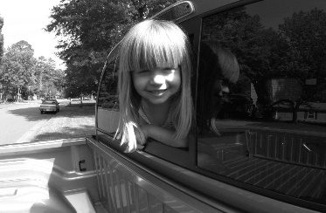
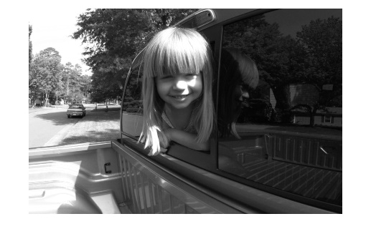
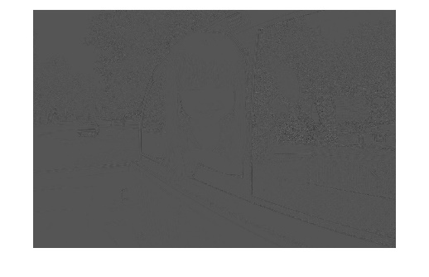
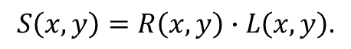
C. Retinex Algorithm
The Singular Value Decomposition (SVD), which is useful for factorizing given data and revealing the underlying structure of their distribution [31, 32], was applied to estimate the illumination component by defining the small local patch at each pixel position and conduct the orthogonal transform for the corresponding region.
$$S\left(x, y\right)=R\left(x, y\right)∙L\left(x, y\right).$$
Notes:
奇異值分解（SVD）可用於分解給定數據並揭示其分佈的基礎結構[31，32]，它通過在每個像素位置定義小的局部斑塊並進行正交來估計照明分量。 轉換為相應的區域。

Slide 11
III. Proposed Method

Slide 12
A. Illumination Estimation via Induced Norm

Slide 13


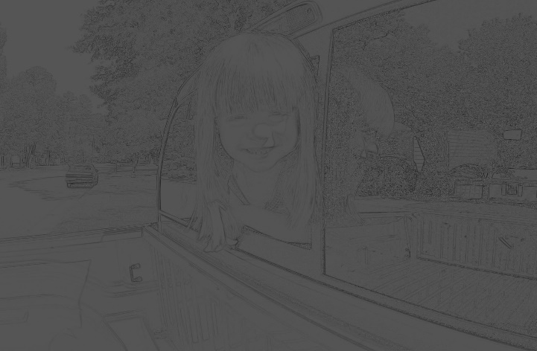
A. Illumination Estimation via Induced Norm
The illumination component is estimated by defining a small local patch at each pixel position. The small local patch denoted as B(x, y) of size N × N pixels is centered at (x, y) pixel position, where N is set to be 5.
Notes:
通過在每個像素位置定義一個小的局部斑塊來估算照明分量。 表示為大小N×N像素的B（x，y）的小局部面片以（x，y）像素位置為中心，其中N設置為5。

Slide 14
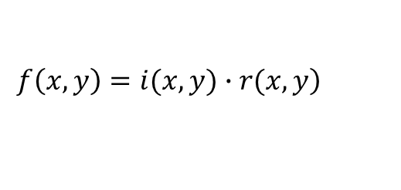
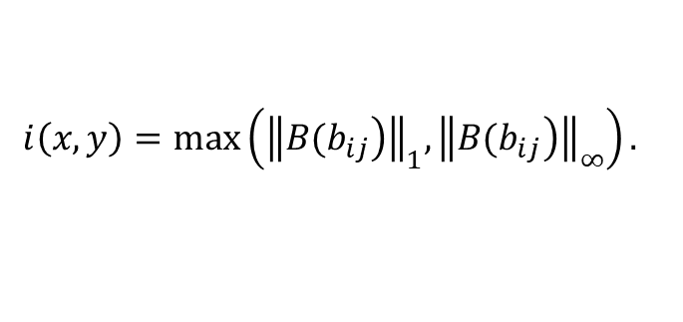
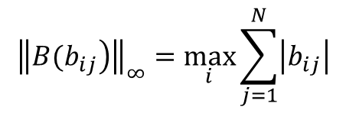
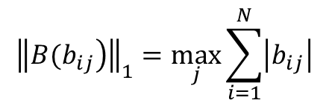
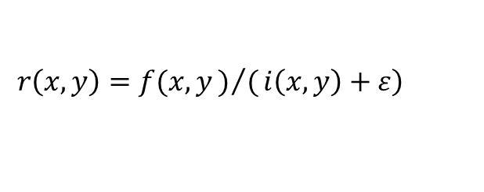
A. Illumination Estimation via Induced Norm
$${\left\|\left.B(b_{ij}\right)\right\|}_{1}=\max_{j}{\sum_{i=1}^{N}{\left|b_{ij}\right|}}$$
$${\left\|\left.B(b_{ij}\right)\right\|}_{∞}=\max_{i}{\sum_{j=1}^{N}{\left|b_{ij}\right|}}$$
$$i\left(x, y\right)=\max\left({\left\|\left.B(b_{ij}\right)\right\|}_{1}, {\left\|\left.B(b_{ij}\right)\right\|}_{∞}\right).$$
$$\left.f\left(x, y\right)=i(x,y)∙r(x,y\right)$$
$$\left.r\left(x,y\right)=f(x,y)/(i\left(x,y\right)+ε\right)$$

Slide 15
B. Image Enhancement by Pre-gamma Correction

Slide 16
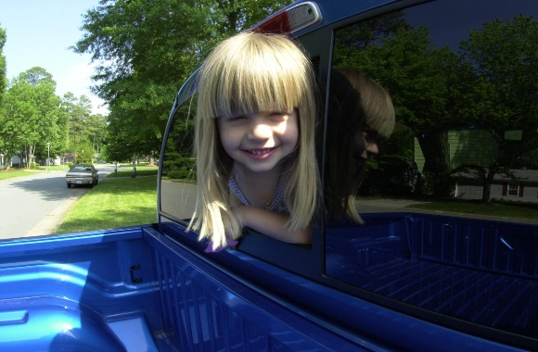
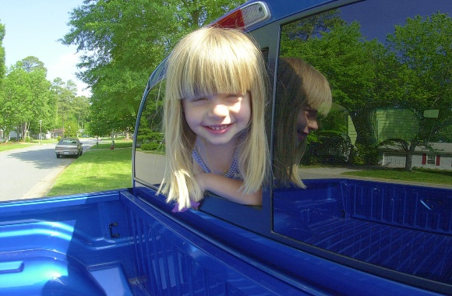
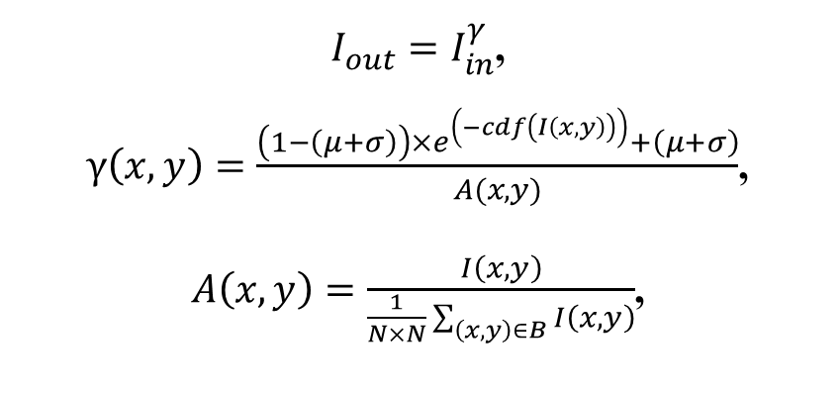
B. Image Enhancement by Pre-gamma Correction
An adaptive gamma correction based on local patch is proposed to pre-process all types of low dynamic range images enhancement as follows:
$I_{out}=I_{in}^{γ}$,
$γ\left(x,y\right)=\frac{\left(1−\left(μ+σ\right)\right){×e}^{\left(−cdf\left(I\left(x,y\right)\right)\right)}+\left(μ+σ\right)}{A(x,y)}$,
$A\left(x,y\right)=\frac{I\left(x,y\right)}{\frac{1}{N×N}\sum_{\left(x, y\right)∈B}{I\left(x,y\right)}}$,
Non-local
Local
Notes:
小數 的次方 超過1 就越小
小數 的次方 低於1 就越大
提出了一種基於局部補丁的自適應伽馬校正，以對所有類型的低動態範圍圖像進行預處理，具體如下：

Slide 17
D. Noise Reduction Method

Slide 18
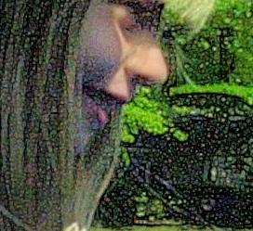
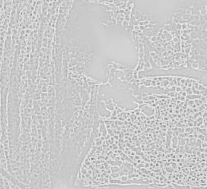
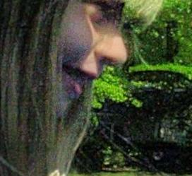
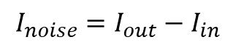
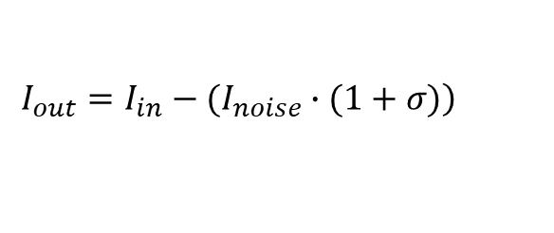
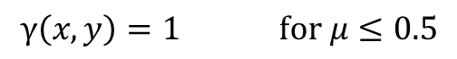
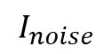
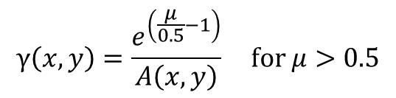
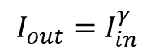
D. Noise Reduction Method
A noise reduction algorithm is proposed to reduce noise from the image as follows:
$$I_{out}=I_{in}^{γ}$$
$$γ\left(x,y\right)=\frac{e^{\left(\frac{μ}{0.5}−1\right)}}{A\left(x,y\right)} for μ>0.5$$
$$γ\left(x,y\right)=1 for μ≤0.5$$
$$I_{noise}$$
$$I_{noise}=I_{out}−I_{in}$$
$$\left.{I_{out}=I_{in}−(I}_{noise}∙(1+σ)\right)$$
Notes:
提出了一種降噪算法來降低圖像的噪點，如下所示：

Slide 19
E. Image Enhancement by Post-Gamma Correction

Slide 20
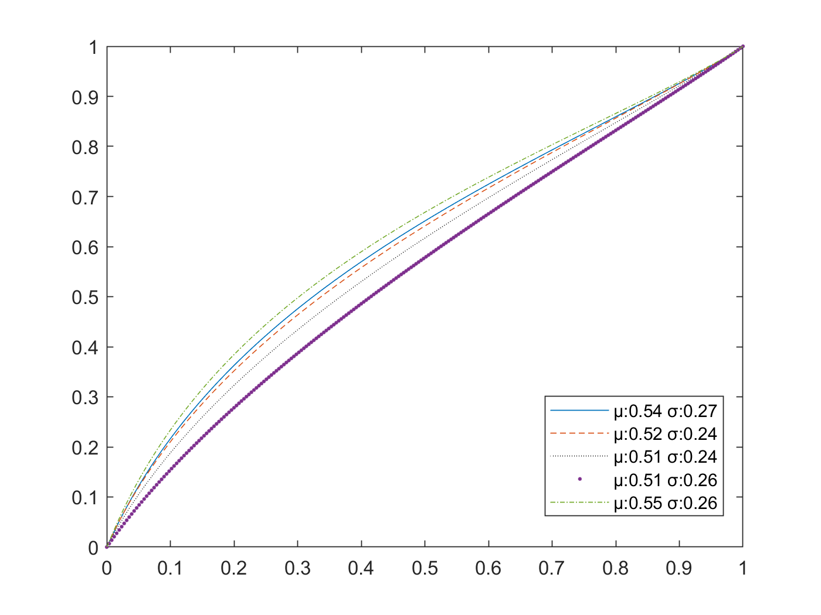
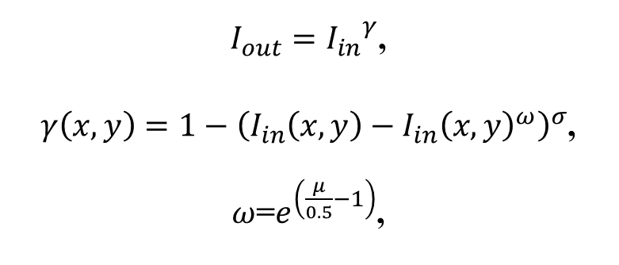
E. Image Enhancement by Post-Gamma Correction
After applying CLAHE, the intensities of the image are scattered over the entire dynamic range, and brightness correction may become more critical than contrast enhancement. A post-gamma correction is proposed to adjust the brightness of the image as follows.
$I_{out}={I_{in}}^{γ}$,
$γ\left(x,y\right)={1−\left(I_{in}\left(x,y\right)−{I_{in}\left(x,y\right)}^{ω}\right)}^{σ}$,
$ω$=$e^{\left(\frac{μ}{0.5}−1\right)}$,
Notes:
應用CLAHE之後，圖像的強度會散佈在整個動態範圍內，並且亮度校正可能比對比度增強更為關鍵。 提出了後伽瑪校正以如下調整圖像的亮度。

Slide 21
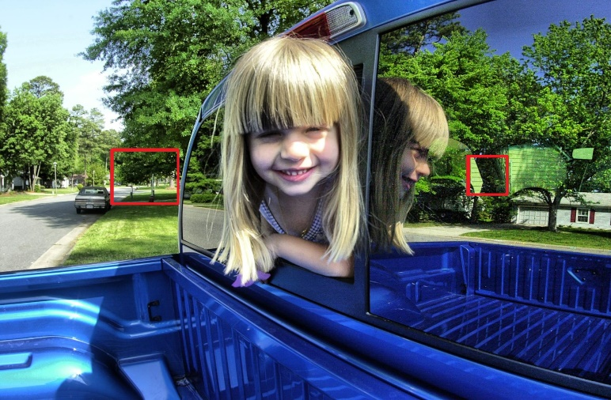
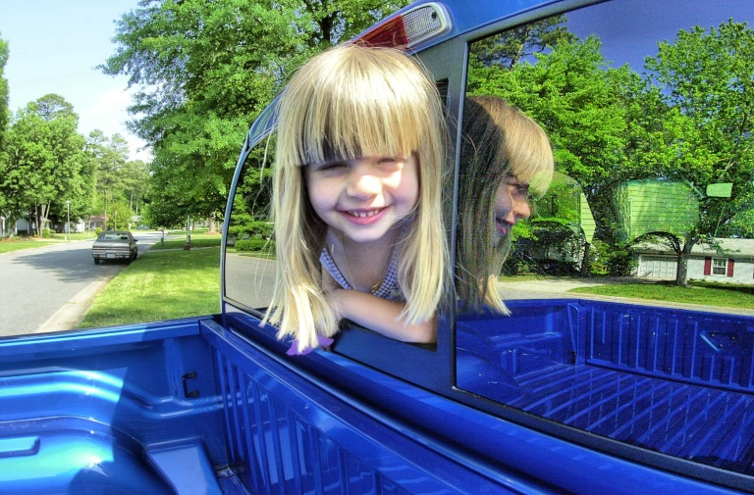
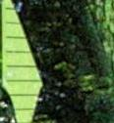
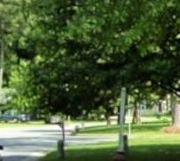
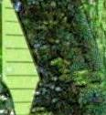
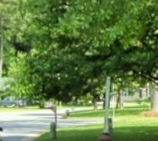
E. Image Enhancement by Post-Gamma Correction

Slide 22
IV. Experimental Results
Core i9-9900X CPU at 3.60GHz, 64GB RAM, Matlab version 2020a.
The test samples were taken from the NASA database [49], Hasinoff et al. [50], Guo et al. [30], and a small part of the images were searched by Google Images.
The sizes of the test images are from 640 × 449 pixels to 8,670 × 5,526 pixels.

Slide 23
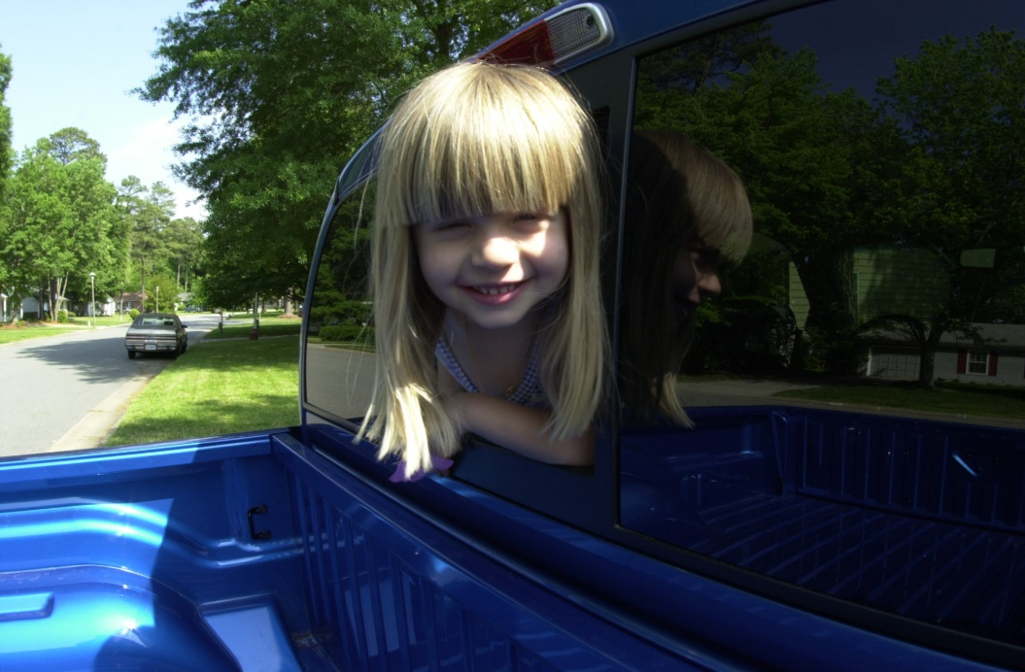
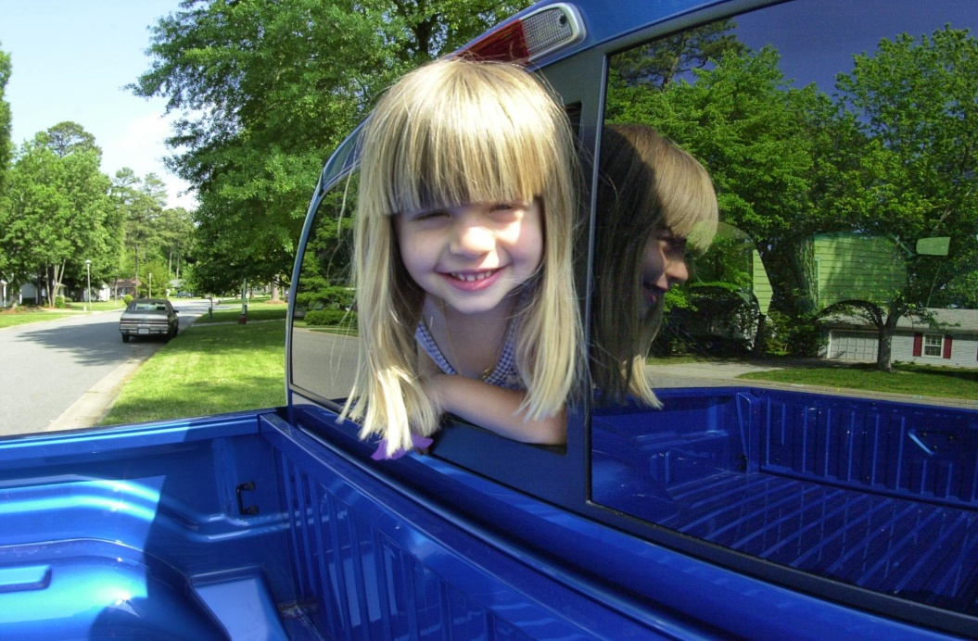
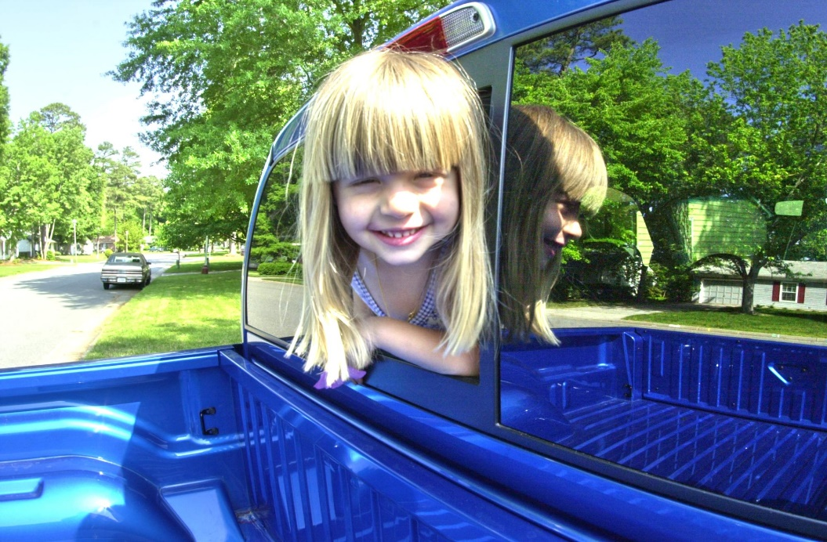
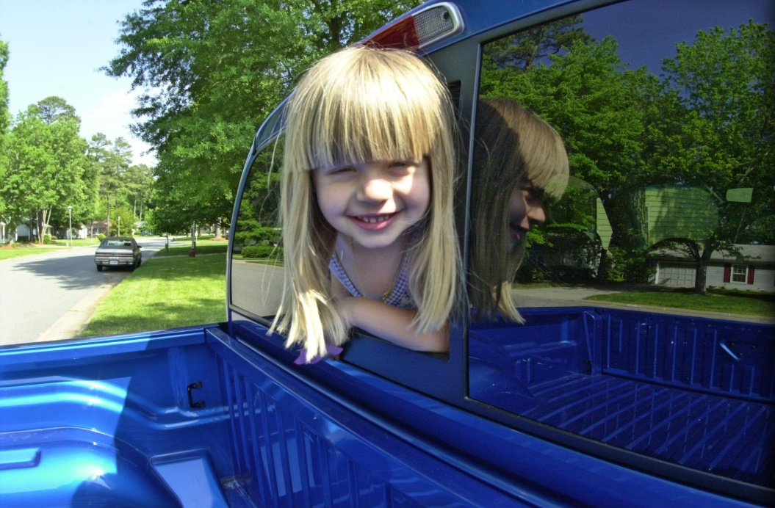
IV. Experimental Results
Original
ICEBIN
LIME
WVM

Slide 24
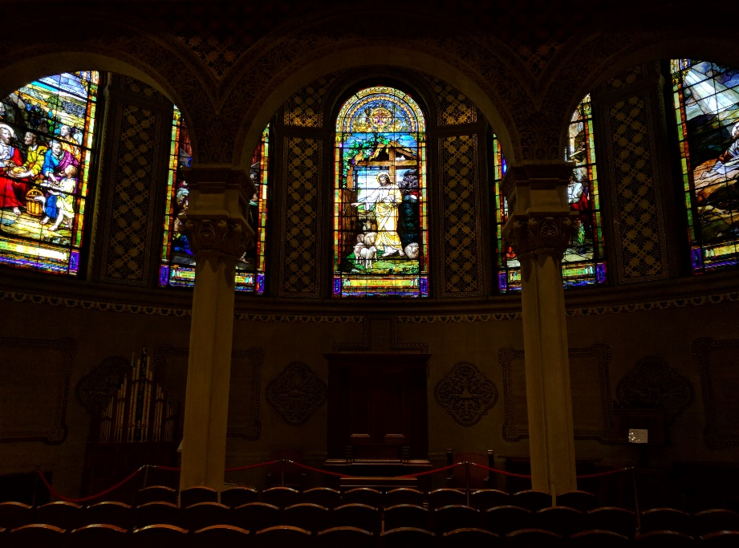
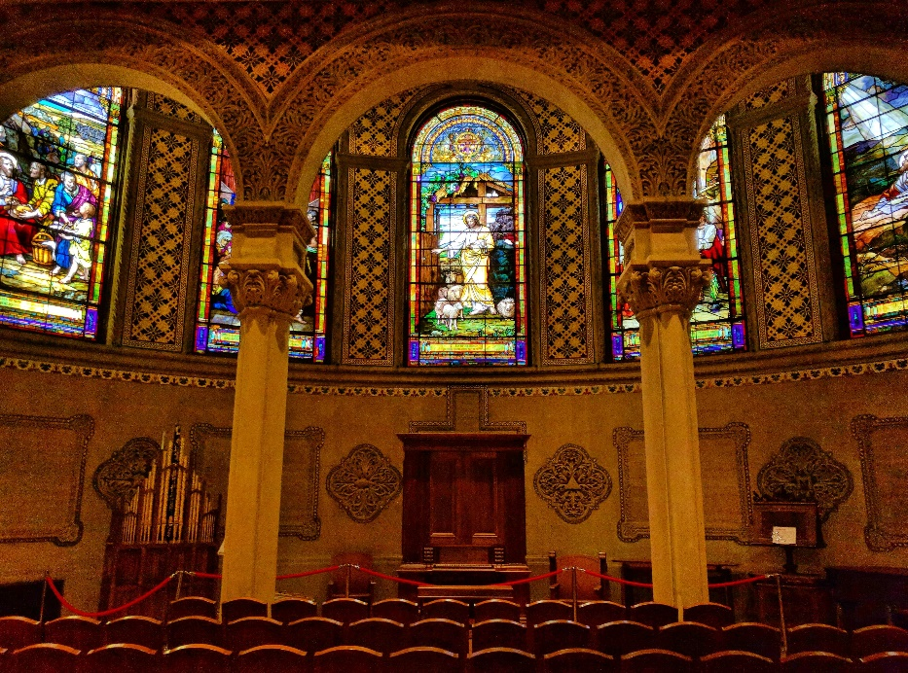
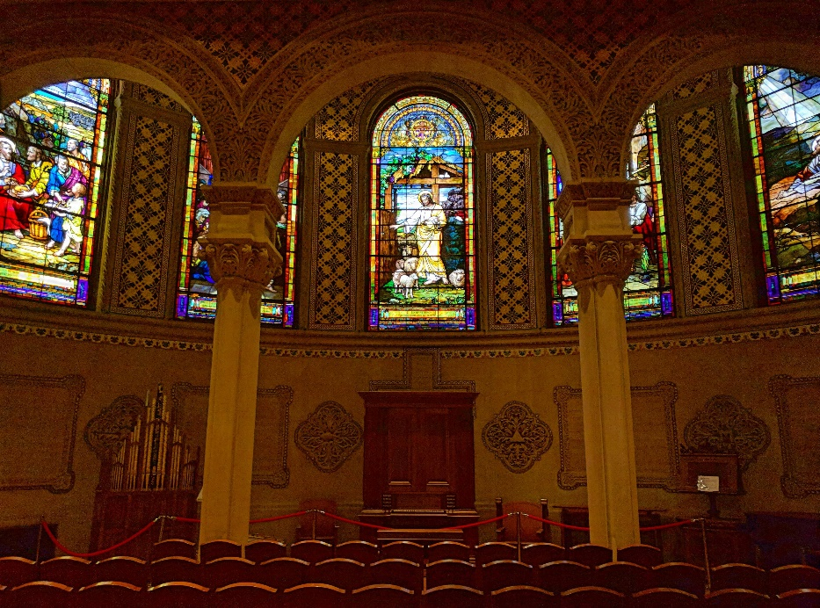
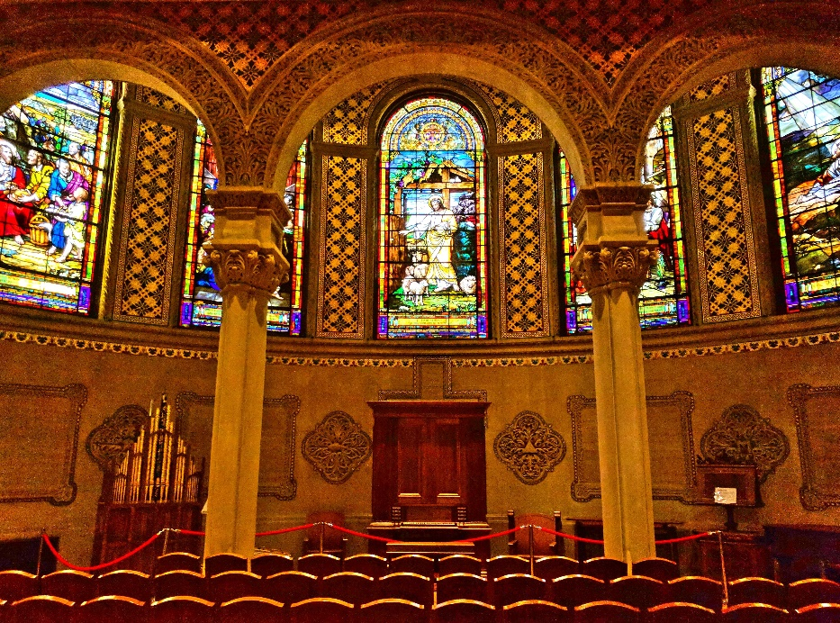
IV. Experimental Results
Original
ICEBIN
WVM
LIME

Slide 25
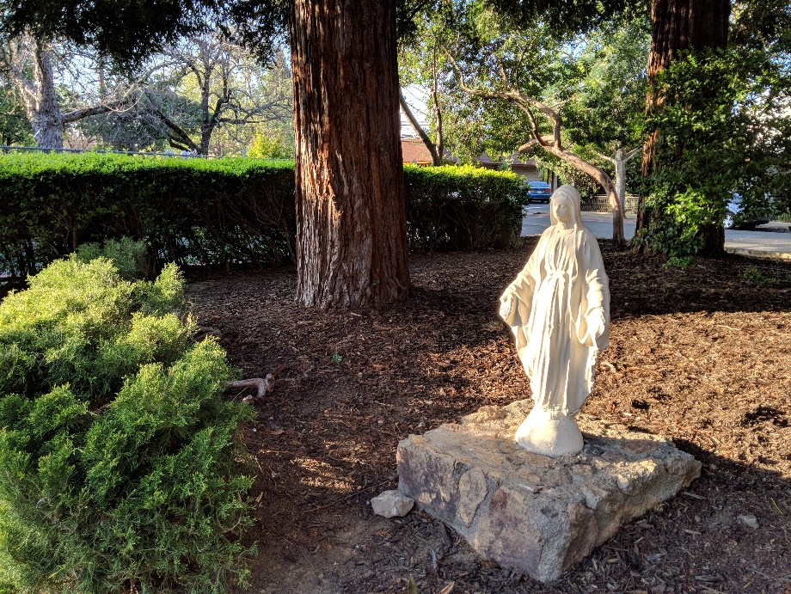
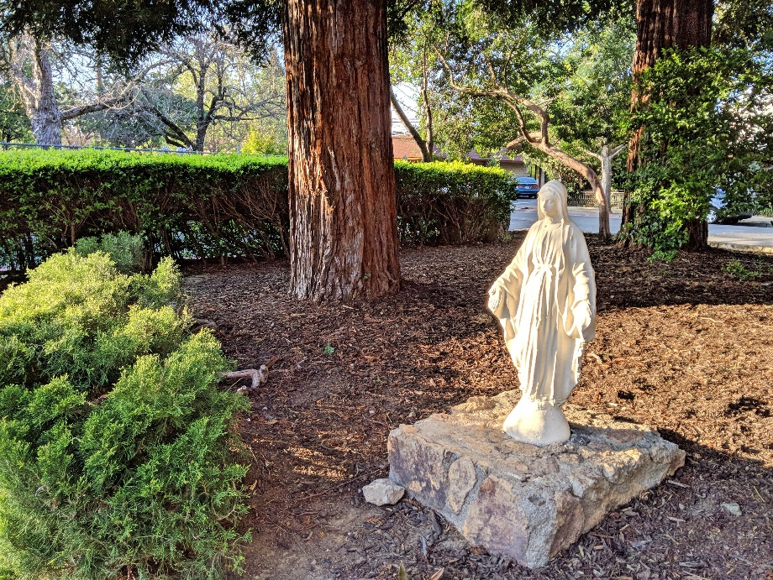


IV. Experimental Results
Original
WVM
ICEBIN
LIME

Slide 26




IV. Experimental Results
Original
WVM
LIME
ICEBIN

Slide 27




IV. Experimental Results
Original
LIME
ICEBIN
WVM

Slide 28




IV. Experimental Results
Original
ICEBIN
LIME
WVM

Slide 29




IV. Experimental Results
Original
LIME
ICEBIN
WVM

Slide 30




IV. Experimental Results
Original
WVM
LIME
ICEBIN

Slide 31




IV. Experimental Results
Original
ICEBIN
WVM
LIME

Slide 32




IV. Experimental Results
Original
WVM
LIME
ICEBIN

Slide 33
References
[1] P. E. Debevec, and J. Malik, “Recovering High Dynamic Range Radiance Maps from Photographs,” in Proceedings of the 24th annual conference on Computer graphics and interactive techniques, New York, NY, USA, pp. 369–378, 1997.
[2] T. Mitsunaga, and S. K. Nayar, “Radiometric Self Calibration,” in Proc. IEEE Computer Society Conf. on Computer Vision and Pattern Recognition, Fort Collins, CO, USA, pp. 374-380, 1999.
[3] M. A. Robertson, S. Borman, and R. L. Stevenson, “Estimation-Theoretic Approach to Dynamic Range Enhancement Using Multiple Exposures,” J. Electron. Imaging, vol. 12, no. 2, pp. 219-228, Apr, 2003.
[4] S. B. Kang, M. Uyttendaele, S. Winder, and R. Szeliski, “High Dynamic Range Video,” ACM Trans. Graphics, vol. 22, no. 3, pp. 319-325, Jul, 2003.
[5] E. Reinhard, W. Heidrich, P. Debevec, S. Pattanaik, G. Ward, and K. Myszkowski, “High Dynamic Range Imaging: Acquisition, Display, and Image-Based Lighting,” Burlington, Massachusetts, Morgan Kaufmann, 2010, pp. 91-117.
[6] C. L. Li, J. H. Liu, A. Y. Liu, Q. G. Wu, and L. H. Bi, “Global and Adaptive Contrast Enhancement for Low Illumination Gray Images,” IEEE Access, vol. 7, pp. 163395-163411, 2019.
[7] S. H. Yun, J. H. Kim, and S. Kim, “Contrast Enhancement Using a Weighted Histogram Equalization,” in IEEE Int. Conf. on Consum. Electron., pp. 203-204, 2011.
[8] C. Wang, and Z. F. Ye, “Brightness Preserving Histogram Equalization with Maximum Entropy: A Variational Perspective,” IEEE Trans. Consum. Electron., vol. 51, no. 4, pp. 1326-1334, Nov, 2005.
[9] S. F. Tan, and N. A. M. Isa, “Exposure Based Multi-Histogram Equalization Contrast Enhancement for Non-Uniform Illumination Images,” IEEE Access, vol. 7, pp. 70842-70861, 2019.
[10] H. Ibrahim, and N. S. P. Kong, “Brightness Preserving Dynamic Histogram Equalization for Image Contrast Enhancement,” IEEE Trans. Consum. Electron., vol. 53, no. 4, pp. 1752-1758, 2007.

Slide 34
References
[11] E. H. Land, “The Retinex Theory of Color Vision,” Sci. Am., vol. 237, no. 6, pp. 108-129, 1977.
[12] D. J. Jobson, Z. U. Rahman, and G. A. Woodell, “Properties and Performance of a Center/Surround Retinex,” IEEE Trans. Image Process., vol. 6, no. 3, pp. 451-462, Mar, 1997.
[13] D. J. Jobson, Z. U. Rahman, and G. A. Woodell, “A Multiscale Retinex for Bridging the Gap between Color Images and the Human Observation of Scenes,” IEEE Trans. Image Process., vol. 6, no. 7, pp. 965-976, Jul, 1997.
[14] M. Herscovitz, and O. Yadid-Pecht, “A Modified Multi Scale Retinex Algorithm with an Improved Global Impressionof Brightness for Wide Dynamic Range Pictures,” Machine Vision and Applications, vol. 15, no. 4, pp. 220-228, 2004.
[15] Z. U. Rahman, and D. J. Jobson, “Retinex Processing for Automatic Image Enhancement,” J. Electron. Imaging, vol. 13, no. 1, pp. 100-110, Jan, 2004.
[16] C. Xiao, and Z. Shi, “Adaptive Bilateral Filtering and Its Application in Retinex Image Enhancement,” in Seventh International Conference on Image and Graphics, Qingdao, China, pp. 45-49, 2013.
[17] W. Kim, “Image Enhancement Using Patch-Based Principal Energy Analysis,” IEEE Access, vol. 6, pp. 72620-72628, 2018.
[18] B. Li, S. Wang, and Y. Geng, “Image Enhancement Based on Retinex and Lightness Decomposition,” in 18th IEEE Int. Conf. on Image Process., Brussels, Belgium, pp. 3417-3420, 2011.
[19] J. Wang, and Y. Z. Hu, “An Improved Enhancement Algorithm Based on Cnn Applicable for Weak Contrast Images,” IEEE Access, vol. 8, pp. 8459-8476, 2020.
[20] Y. H. Guo, X. Ke, J. Ma, and J. Zhang, “A Pipeline Neural Network for Low-Light Image Enhancement,” IEEE Access, vol. 7, pp. 13737-13744, 2019.

Slide 35
References
[21] C. Guo, C. Li, J. Guo, C. C. Loy, J. Hou, S. Kwong, and R. Cong, “Zero-Reference Deep Curve Estimation for Low-Light Image Enhancement,” in Proc. of the IEEE/CVF Conf. on Computer Vision and Pattern Recognition, pp. 1780-1789, 2020.
[22] E. H. Land, “The Retinex,” Am. Sci., vol. 52, no. 2, pp. 247-264, 1964.
[23] E. H. Land, “Recent Advances in Retinex Theory,” Vision Res., vol. 26, no. 1, pp. 7-21, 1986.
[24] E. H. Land, and J. J. McCann, “Lightness and Retinex Theory,” Journal of the Optical Society of America, vol. 61, no. 1, pp. 1-11, 1971.
[25] M. Bertalmio, V. Caselles, and E. Provenzi, “Issues About Retinex Theory and Contrast Enhancement,” Int. J. Comput. Vision, vol. 83, no. 1, pp. 101-119, Jun, 2009.
[26] G. Deng, “A Generalized Unsharp Masking Algorithm,” IEEE Trans. Image Process., vol. 20, no. 5, pp. 1249-1261, May, 2011.
[27] S. H. Wang, J. Zheng, H. M. Hu, and B. Li, “Naturalness Preserved Enhancement Algorithm for Non-Uniform Illumination Images,” IEEE Trans. Image Process., vol. 22, no. 9, pp. 3538-3548, Sep, 2013.
[28] H. J. Yue, J. Y. Yang, X. Y. Sun, F. Wu, and C. P. Hou, “Contrast Enhancement Based on Intrinsic Image Decomposition,” IEEE Trans. Image Process., vol. 26, no. 8, pp. 3981-3994, Aug, 2017.
[29] J. B. Shen, X. S. Yang, X. L. Li, and Y. D. Jia, “Intrinsic Image Decomposition Using Optimization and User Scribbles,” IEEE Trans. Cybern., vol. 43, no. 2, pp. 425-436, Apr, 2013.
[30] X. J. Guo, Y. Li, and H. B. Ling, “Lime: Low-Light Image Enhancement Via Illumination Map Estimation,” IEEE Trans. Image Process., vol. 26, no. 2, pp. 982-993, Feb, 2017.

Slide 36
References
[31] J. Stauder, R. Mech, and J. Ostermann, “Detection of Moving Cast Shadows for Object Segmentation,” IEEE Trans. Multimedia, vol. 1, no. 1, pp. 65-76, Mar, 1999.
[32] Z. Wei, F. Xiang Zhong, and X. Yi, “Detection of Moving Cast Shadows Using Image Orthogonal Transform,” in 18th Int. Conf. on Pattern Recognition, Hong Kong, China, pp. 626-629, 2006.
[33] S. Chen, and A. Beghdadi, “Natural Rendering of Color Image Based on Retinex,” in 16th IEEE Int. Conf. on Image Process., Cairo, Egypt, pp. 1813-1816, 2009.
[34] S. H. Chen, and A. Beghdadi, “Natural Enhancement of Color Image,” Eurasip J Image Vide, pp. 1-19, Dec, 2010.
[35] S. C. Huang, F. C. Cheng, and Y. S. Chiu, “Efficient Contrast Enhancement Using Adaptive Gamma Correction with Weighting Distribution,” IEEE Trans. Image Process., vol. 22, no. 3, pp. 1032-1041, Mar, 2013.
[36] C. L. Li, S. Q. Tang, J. W. Yan, and T. Zhou, “Low-Light Image Enhancement Via Pair of Complementary Gamma Functions by Fusion,” IEEE Access, vol. 8, pp. 169887-169896, 2020.
[37] R. C. Gonzalez, and R. E. Woods, “Digital Image Processing,” New Jersey, Prentice-Hall, 2008.
[38] Y. T. Kim, “Quantized Bi-Histogram Equalization,” in IEEE Int. Conf. on Acoustics, Speech, and Signal Process., Munich, Germany, pp. 2797-2800, 1997.
[39] Y. T. Kim, “Contrast Enhancement Using Brightness Preserving Bi-Histogram Equalization,” IEEE Trans. Consum. Electron., vol. 43, no. 1, pp. 1-8, Feb, 1997.
[40] V. Stimper, S. Bauer, R. Ernstorfer, B. Scholkopf, and R. P. Xian, “Multidimensional Contrast Limited Adaptive Histogram Equalization,” IEEE Access, vol. 7, pp. 165437-165447, 2019.

Slide 37
References
[41] D. Menotti, L. Najman, J. Facon, and A. D. A. Araujo, “Multi-Histogram Equalization Methods for Contrast Enhancement and Brightness Preserving,” IEEE Trans. Consum. Electron., vol. 53, no. 3, pp. 1186-1194, 2007.
[42] A. Mehrish, A. V. Subramanyam, and S. Emmanuel, “Joint Spatial and Discrete Cosine Transform Domain-Based Counter Forensics for Adaptive Contrast Enhancement,” IEEE Access, vol. 7, pp. 27183-27195, 2019.
[43] C. Ding, X. P. Pan, X. Y. Gao, L. H. Ning, and Z. K. Wu, “Three Adaptive Sub-Histograms Equalization Algorithm for Maritime Image Enhancement,” IEEE Access, vol. 8, pp. 147983-147994, 2020.
[44] S. M. Pizer, E. P. Amburn, J. D. Austin, R. Cromartie, A. Geselowitz, T. Greer, B. ter Haar Romeny, J. B. Zimmerman, and K. Zuiderveld, “Adaptive Histogram Equalization and Its Variations,” Computer vision, graphics, and image processing, vol. 39, no. 3, pp. 355-368, 1987.
[45] J. Y. Kim, L. S. Kim, and S. H. Hwang, “An Advanced Contrast Enhancement Using Partially Overlapped Sub-Block Histogram Equalization,” IEEE Trans. Circuits Syst. Video Technol., vol. 11, no. 4, pp. 475-484, Apr, 2001.
[46] W. C. Wang, X. J. Wu, X. H. Yuan, and Z. R. Gao, “An Experiment-Based Review of Low-Light Image Enhancement Methods,” IEEE Access, vol. 8, pp. 87884-87917, 2020.
[47] K. Zuiderveld, “Contrast Limited Adaptive Histogram Equalization,” Graphics gems, pp. 474-485, 1994.
[48] Y. Chang, C. Jung, P. Ke, H. Song, and J. Hwang, “Automatic Contrast-Limited Adaptive Histogram Equalization with Dual Gamma Correction,” IEEE Access, vol. 6, pp. 11782-11792, Mar, 2018.
[49] NASA. "Retinex Image Processing," 2001; http://dragon.larc.nasa.gov/retinex/.
[50] S. W. Hasinoff, D. Sharlet, R. Geiss, A. Adams, J. T. Barron, F. Kainz, J. W. Chen, and M. Levoy, “Burst Photography for High Dynamic Range and Low-Light Imaging on Mobile Cameras,” ACM Trans. Graphics, vol. 35, no. 6, Nov, 2016.

Slide 38
References
[51] T. Celik, and T. Tjahjadi, “Contextual and Variational Contrast Enhancement,” IEEE Trans. Image Process., vol. 20, no. 12, pp. 3431-3441, Dec, 2011.
[52] C. Lee, C. Lee, and C. S. Kim, “Contrast Enhancement Based on Layered Difference Representation of 2d Histograms,” IEEE Trans. Image Process., vol. 22, no. 12, pp. 5372-5384, Dec, 2013.
[53] T. Arici, S. Dikbas, and Y. Altunbasak, “A Histogram Modification Framework and Its Application for Image Contrast Enhancement,” IEEE Trans. Image Process., vol. 18, no. 9, pp. 1921-1935, Sep, 2009.
[54] X. Fu, D. Zeng, Y. Huang, X. P. Zhang, and X. Ding, “A Weighted Variational Model for Simultaneous Reflectance and Illumination Estimation,” in Proc. of the IEEE Conf. on Computer Vision and Pattern Recognition, Las Vegas, NV, USA, pp. 2782-2790, 2016.
[55] A. Mittal, A. K. Moorthy, and A. C. Bovik, “No-Reference Image Quality Assessment in the Spatial Domain,” IEEE Trans. Image Process., vol. 21, no. 12, pp. 4695-4708, Dec, 2012.
[56] L. Zhang, L. Zhang, X. Q. Mou, and D. Zhang, “Fsim: A Feature Similarity Index for Image Quality Assessment,” IEEE Trans. Image Process., vol. 20, no. 8, pp. 2378-2386, Aug, 2011.
[57] S. S. Agaian, K. Panetta, and A. M. Grigoryan, “Transform-Based Image Enhancement Algorithms with Performance Measure,” IEEE Trans. Image Process., vol. 10, no. 3, pp. 367-382, Mar, 2001.
[58] K. Gu, D. C. Tao, J. F. Qiao, and W. S. Lin, “Learning a No-Reference Quality Assessment Model of Enhanced Images with Big Data,” IEEE Trans. Neural Networks Learn. Syst., vol. 29, no. 4, pp. 1301-1313, Apr, 2018.
[59] A. Mittal, R. Soundararajan, and A. C. Bovik, “Making a "Completely Blind" Image Quality Analyzer,” IEEE Signal Process Lett., vol. 20, no. 3, pp. 209-212, Mar, 2013.
[60] K. He, J. Sun, and X. Tang, “Single Image Haze Removal using Dark Channel Prior,” in Proc. of the IEEE Conf. on Computer Vision and Pattern Recognition, pages 1956–1963, 2009.

Slide 39
Q & A

Slide 40
Thank you

